Slide 1
SSG
Static Site Generators

Slide 2
Recap

Slide 3
How does the web work?

Slide 4
A typical web site will live or is "hosted" on a web server. Web servers are often large computers connected to a network.

Slide 5

Step 1: Type in the address bar

Slide 6
What next?

Slide 7
Step 2: Your computer performs a DNS lookup
Each website has a unique code, called an IP address, that is like a phone number.
DNS, or Domain Name Servers, are like phone books. The DNS servers will connect you to the right server.
http://www.leedstrinity.ac.uk/ = 192.190.201.206

Slide 8
What next?

Slide 9
Step 3: Your computer connects to the server
Your computer uses the IP address to find the correct web server and sends a request for a page.

Slide 10
What next?

Slide 11
Step 4: The server responds to your request
The server processes your request and finds the right files. Sometimes it has to "compile" a page from code and other sources, like a database.

Slide 12
What next?

Slide 13
Step 5: The server sends your computer the files
This is usually an HTML page, with some CSS, JavaScript, or media files.

Slide 14
What next?

Slide 15
Step 6: Your browser displays the page
Your browser interprets the code and assembles all the files into a page you can see and use.
NB Each browser does this slightly differently 🙄

Slide 16
Dynamic Site
Vs
Static Site

Slide 17

Notes:
How dynamic sites work
Try to imagine for a second that the only way for people to know what's happening in the world is to go to the nearby news kiosk and ask to read the latest news. Yes, I know it's silly but it will all make sense in a bit, please bear with me.
The attendant has no way to know what the latest news are, so he passes the request on to a back room full of telephone operators — picture a big telephone switchboard room in the 1950s. When an operator becomes available, they will take the request and phone a long list of news agencies, ask for the latest news and then write the results as bullet points on a piece of paper.
The operator will then pass his rough notes on to a scribbler who will write the final copy to a nice sheet of paper, arrange them in a certain layout and add a few bits and pieces such as the kiosk branding and contact information. Finally, the attendant takes the finished paper and serves it to the happy customer. The entire process will then be repeated for every person that arrives at the kiosk.
That is essentially how a dynamic website works. When a visitor gets to a website (the kiosk) expecting the latest content (the news), a server-side script (the operators) will query one or multiple databases (news agencies) to get the content, pass the results to a templating engine (the scribble) who will format and arrange everything properly and generate an HTML file (the finished newspaper) for the user to consume.
How static sites work
The proposition of a static site is to shift the heavy load from the moment visitors request the content to the moment content actually changes. Going back to our news kiosk metaphor, think of a scenario where it's the news agencies who call the kiosk whenever something newsworthy happens.
The kiosk operators and scribbles will then compile, format and style the stories and produce a finished newspaper right away, even though nobody ordered one yet. They will print out a huge number of copies (infinite, actually) and pile them up by the store front.
When customers arrive, there's no need to wait for an operator to become available, place the phone call, pass the results to the scribble and wait for the final product. The newspaper is already there, waiting in a pile, so the customer can be served instantly.
And that is how static site generators work. They take the content, typically stored in flat files rather than databases, apply it against layouts or templates and generate a structure of purely static HTML files that are ready to be delivered to the users.

Slide 18
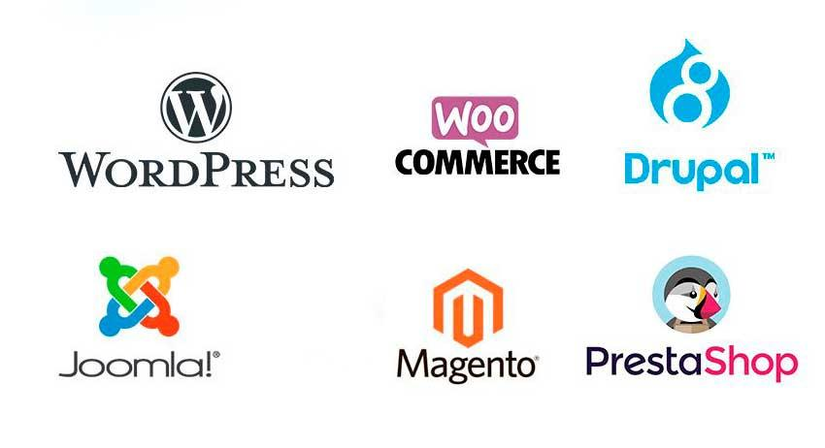

Slide 19
Static site is already built

Slide 20
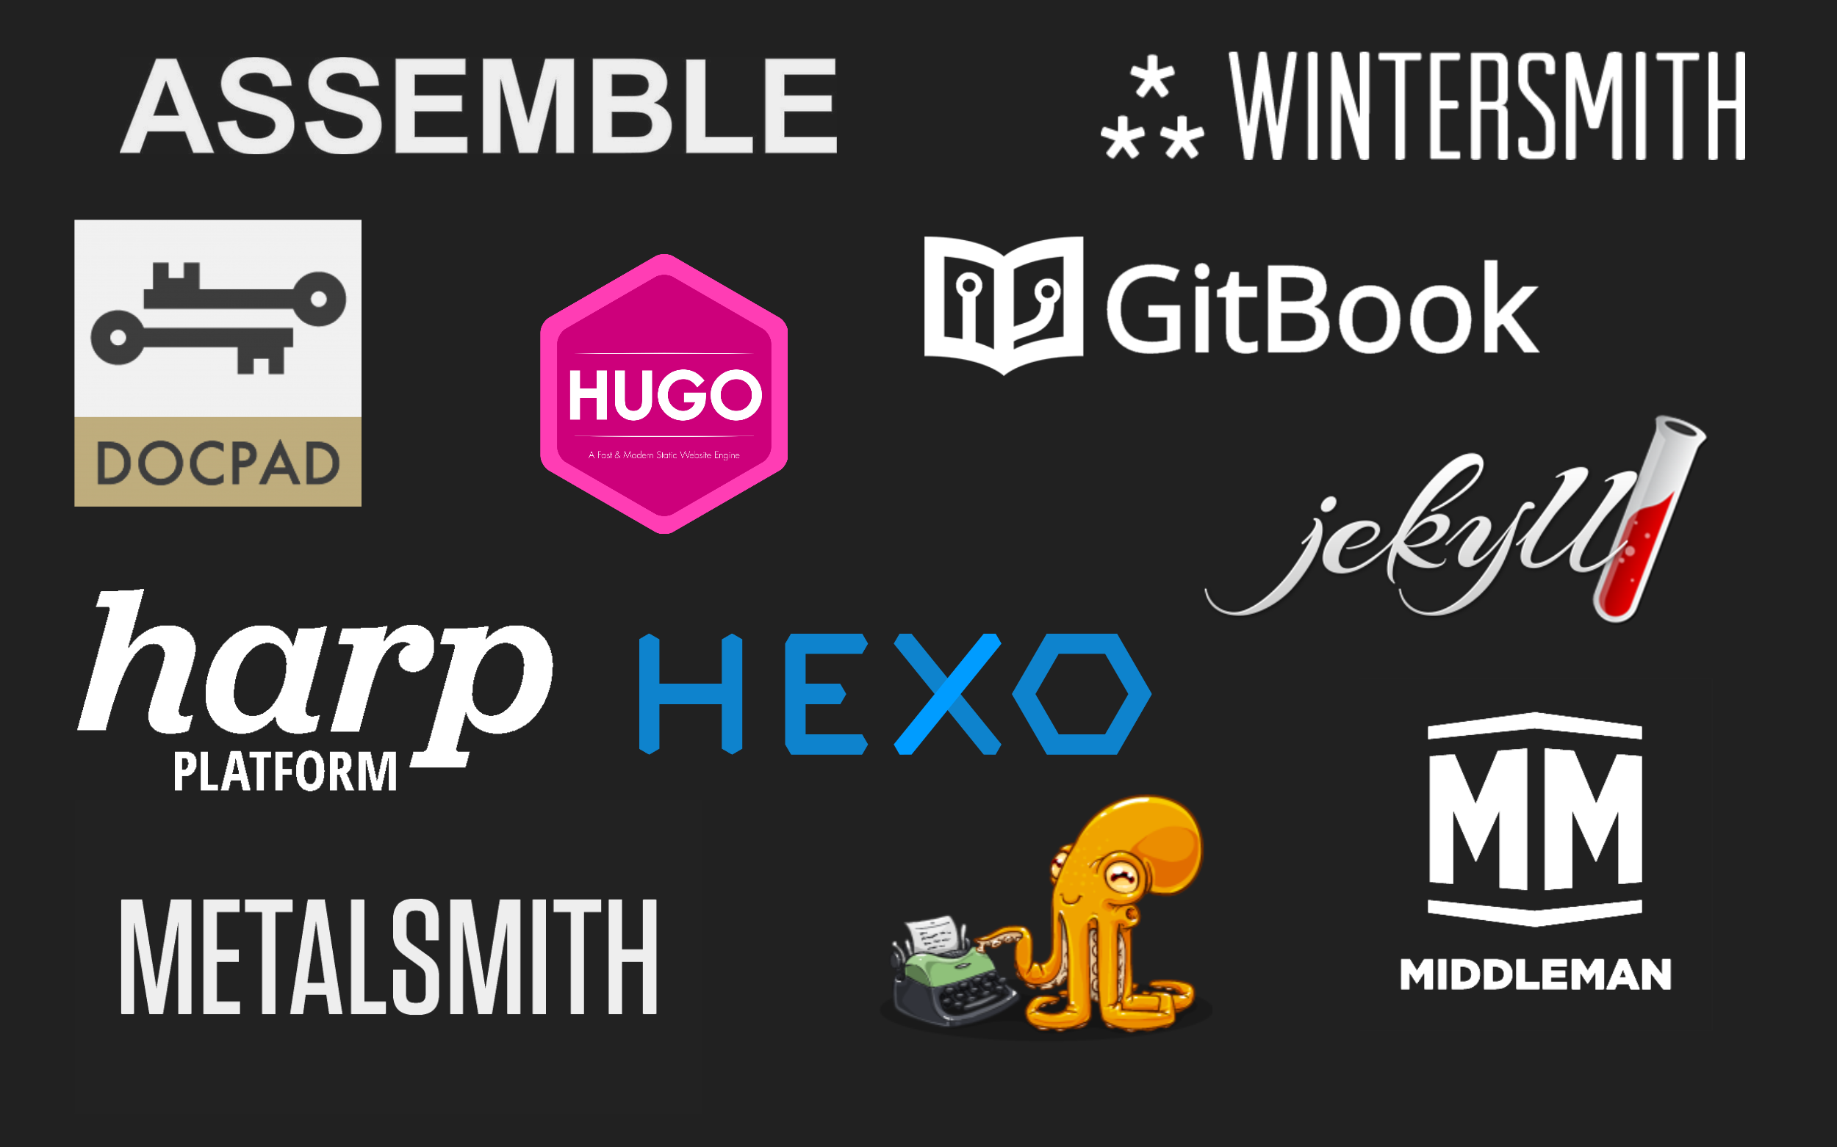
Notes:
Static Site generators have been around for a few years now - these are some of the older popular ones - A slide from when we started teaching this back in 2016

Slide 21

Notes:
These are some of the most popular right now
https://www.staticgen.com/

Slide 22

Notes:
Github has SSG built into github pages so you can create a site really easily

Slide 23


Slide 24
DEMO:
Setting up a Jekyll site for a project on GitHub pages
Notes:
Follow the instructions on the site here for a PROJECT page - the group will do a portfolio page for their username in a later task
https://pages.github.com/

Slide 25
Task 4.1.1
Follow the example set by your trainer to make your LTU-Reboot Digital Coding Repo a Jekyll project hosted with Github pages.
Make some changes to the site to personalise it.
https://pages.github.com/
Set up a Jekyll site using GitHub pages

Slide 26

Notes:
Can you think of any advantages of working in this way?
Advantages of static
1) Speed
2) Version control for content
3) Security
4) Less hassle with the server
5) Traffic surges
1) Speed
Perhaps the most immediately noticeable characteristic of a static site is how fast it is. As mentioned above, there are no database queries to run, no templating and no processing whatsoever on every request.
Web servers are really good at delivering static pages quickly, and the entire site consists of static HTML files that are sitting on the server, waiting to be served, so a request is served back to the user pretty much instantly.
2) Version control for content
You can't even imagine working on a project without version control anymore, can you? Having a repository where people can collaboratively work on files, control exactly who does what and rollback changes when something goes wrong is essential in any software project, no matter how small.
But what about the content? That's the keystone of any site and yet it usually sits in a database somewhere else, completely separated from the codebase and its version control system. In a static site, the content is typically stored in flat files and treated as any other component of the codebase. In a blog, for example, that means being able to have the actual posts stored in a GitHub repository and allowing your readers to file an issue when something is wrong or to add a correction with a pull request — how cool is that?
3) Security
Platforms like WordPress are used by millions of people around the world, meaning they're common targets for hackers and malicious attacks — no way around it. Wherever there's user input/authentication or multiple processes running code on every request, there's a potential security hole to exploit. To be on top of the situation, site administrators need to keep patching their systems with security updates, constantly playing cat and mouse with attackers, a routine that may be overlooked by less experienced users.
Static sites keep it simple, since there's not much to mess up when there's only a web server serving plain HTML pages.
4) Less hassle with the server
Installing and maintaining the infrastructure required to run a dynamic site can be quite challenging, especially when multiple servers are involved or when something needs to be migrated. There's packages, libraries, modules and frameworks with different versions and dependencies, there's different web servers and database engines in different operating systems.
Sure, a static site generator is a software package with its dependencies as well, but that's only relevant at build time, when the site is generated. Ultimately, the end result is a collection of HTML files that can be served anywhere, scaled and migrated as needed regardless of the server-side technologies. As for the site generation process, that can be done from an environment that you control locally and not necessarily on the web server that will run the site — heck, you can build an entire site on your laptop and push the result to the web when it's done.
5) Traffic surges
Unexpected traffic peaks on a website can be a problem, especially when it relies intensively on database calls or heavy processing. Introducing caching layers such as Varnish or Memcached surely helps, but that ends up introducing more possible points of failure in the system.
A static site is generally better prepared for those situations, as serving static HTML pages consumes a very small amount of server resources.

Slide 27
Advantages
1) Speed
2) Version control for content
3) Security
4) Less hassle with the server
5) Traffic surges
Notes:
Advantages of static
1) Speed
2) Version control for content
3) Security
4) Less hassle with the server
5) Traffic surges
1) Speed
Perhaps the most immediately noticeable characteristic of a static site is how fast it is. As mentioned above, there are no database queries to run, no templating and no processing whatsoever on every request.
Web servers are really good at delivering static pages quickly, and the entire site consists of static HTML files that are sitting on the server, waiting to be served, so a request is served back to the user pretty much instantly.
2) Version control for content
You can't even imagine working on a project without version control anymore, can you? Having a repository where people can collaboratively work on files, control exactly who does what and rollback changes when something goes wrong is essential in any software project, no matter how small.
But what about the content? That's the keystone of any site and yet it usually sits in a database somewhere else, completely separated from the codebase and its version control system. In a static site, the content is typically stored in flat files and treated as any other component of the codebase. In a blog, for example, that means being able to have the actual posts stored in a GitHub repository and allowing your readers to file an issue when something is wrong or to add a correction with a pull request — how cool is that?
3) Security
Platforms like WordPress are used by millions of people around the world, meaning they're common targets for hackers and malicious attacks — no way around it. Wherever there's user input/authentication or multiple processes running code on every request, there's a potential security hole to exploit. To be on top of the situation, site administrators need to keep patching their systems with security updates, constantly playing cat and mouse with attackers, a routine that may be overlooked by less experienced users.
Static sites keep it simple, since there's not much to mess up when there's only a web server serving plain HTML pages.
4) Less hassle with the server
Installing and maintaining the infrastructure required to run a dynamic site can be quite challenging, especially when multiple servers are involved or when something needs to be migrated. There's packages, libraries, modules and frameworks with different versions and dependencies, there's different web servers and database engines in different operating systems.
Sure, a static site generator is a software package with its dependencies as well, but that's only relevant at build time, when the site is generated. Ultimately, the end result is a collection of HTML files that can be served anywhere, scaled and migrated as needed regardless of the server-side technologies. As for the site generation process, that can be done from an environment that you control locally and not necessarily on the web server that will run the site — heck, you can build an entire site on your laptop and push the result to the web when it's done.
5) Traffic surges
Unexpected traffic peaks on a website can be a problem, especially when it relies intensively on database calls or heavy processing. Introducing caching layers such as Varnish or Memcached surely helps, but that ends up introducing more possible points of failure in the system.
A static site is generally better prepared for those situations, as serving static HTML pages consumes a very small amount of server resources.

Slide 28
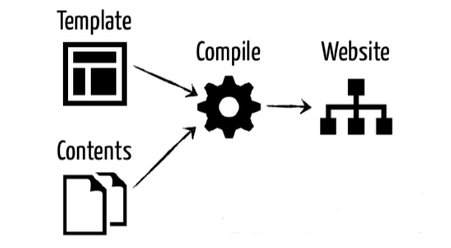

Slide 29


Slide 30


Slide 31

Notes:
https://www.11ty.dev/

Slide 32


Slide 33
Demo:
11ty site deployed using Netlify
Notes:
Use one of the preconfigured starter kits to deploy a site to netlify I recommend this one
https://github.com/scottishstoater/jamstack-web-starter
Has a deploy to netlify button to show how quick that is
talk about what is happening in scripts as it deploys
Look through the readme file
Talk about the different libraries and frameworks
Run the site locally
Talk about automation and compiling etc
Make a change to the site push it to the repo
Deploy the change

Slide 34
Takeaway Task 4.1.2
Follow the instructions to create a static profile page for yourself
pages.github.com/
Create an profile.html
And add the following :

Slide 35
Takeaway Task 4.1.2
What we are expecting is:
Image (of you)
Intro text or mini bio
Link to your GitHub profile
Link to your CodePen profile
Links to your other social profiles - Twitter / LinkedIn etc.
Anything else…
Some examples to follow
(continued)

Slide 36


Slide 37


Slide 38
Questions?

